Slide 1
Controlling Volume with Hand Gestures
BY SHREYAS S N

Slide 2
Milestone 3
Module: Volume Mapping and Control Module
Primary Goal: To develop a utility that controls system volume programmatically without opening Windows settings.

Slide 3
Technology Stack (The "Tools" Used)
1
pycaw
2
comtypes
4
3
Customtkinter
Acts as the bridge between our Python script and the Windows OS.
The core library used to interact directly with the Windows Audio Endpoint APIs.
threading
Responsible for rendering the volume slider, status buttons, and the main dashboard window.
Used to run the "Hotkey Listener" and "GUI" simultaneously.

Slide 4
Windows Core Audio Architecture
1. eRender (Value: 0)
This is the system constant used to identify Audio Render Devices.
We use this to select and control Speakers or Headphones.
2. eCapture (Value: 1)
This is the system constant used to identify Audio Capture Devices.
We use this to select and control the Microphone.
3. IMMDeviceEnumerator
This acts as the "scanner" for your system.
It lists all available audio hardware connected to your PC so the code can find them.
4. IAudioEndpointVolume
This is the specific interface ("The Knob").
It is the only interface that allows us to actually change volume levels or toggle mute.

Slide 5
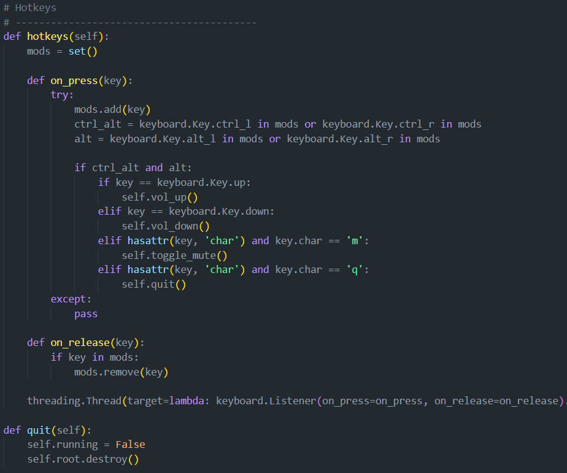
Program part

Slide 6
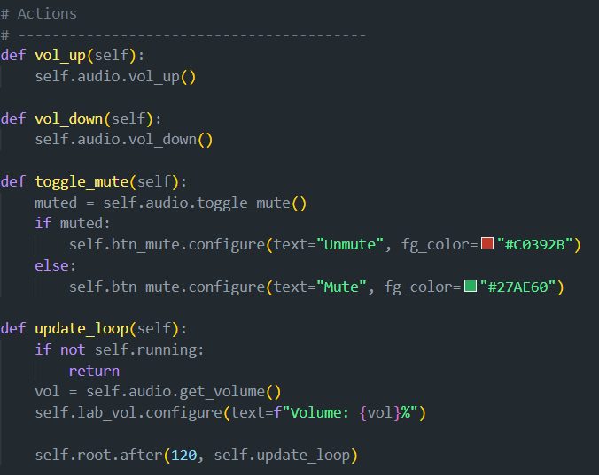

Slide 7
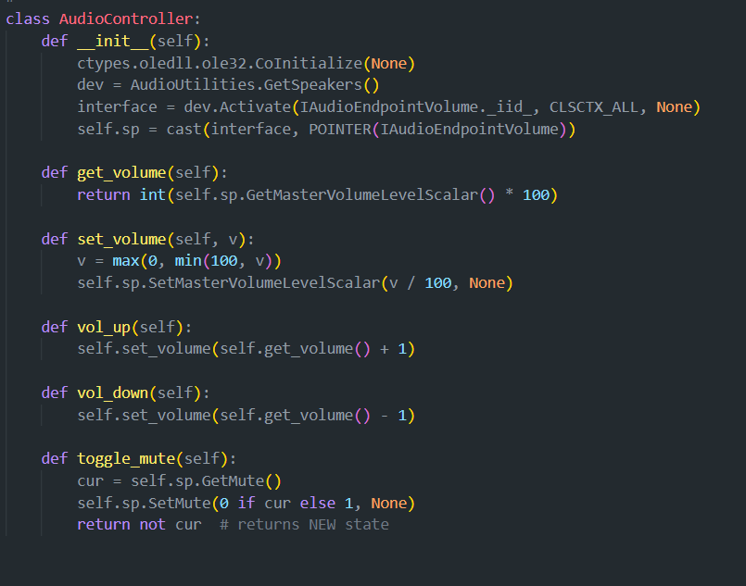

Slide 8
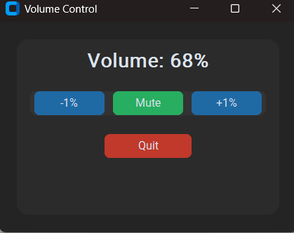
Ui simple design

Slide 9
Thank you

